Slide 1


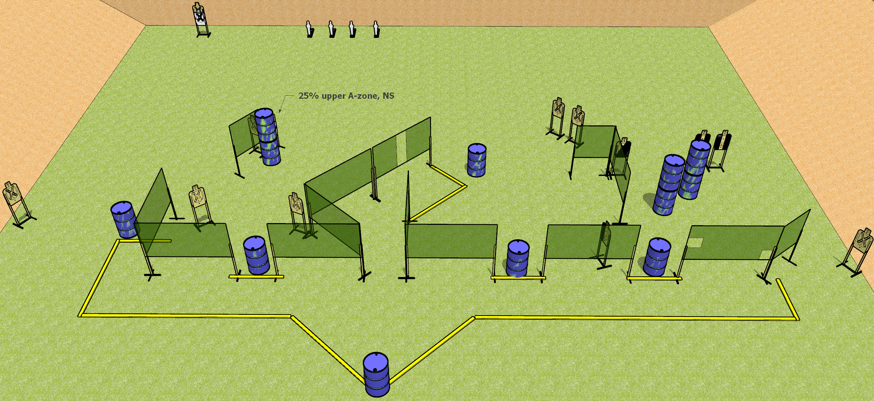
 | Dothan Gun Club – USPSA Match Here There Everywhere Course Designer : Drew Coleman
START POSITION : Standing with hands on knees *behind the rearmost barrel. *Uprange of and within the lateral confines of the specified object; e.g. "standing behind the table" means uprange of the table and inside the lines defined by the edges of the table (Appendix A3)
GUN READY CONDITION : Firearm loaded, safety on, placed unsupported on the barrel. All other magazines to be used in stage must be placed on ANY OTHER barrel |  | SCORING: Comstock, 30 rounds TARGETS: 14 paper, 4 Steel SCORED HITS: Best 2 on paper, steel until down START-STOP: Audible, last shot RULES:
STAGE PROCEDURE: Engage targets as they become available from within the fault lines.

Slide 2
Here There Everywhere
Written Stage Briefing
Here There Everywhere is a 30 round, 150 point, Comstock field course. There are fourteen USPSA targets and four mini poppers. The best two hits on paper will score, and steel must fall to score. The start signal is audible.
Start position is standing behind* the rearmost barrel, hands on knees. Firearm is loaded, safety on, laying unsupported on rearmost barrel. All other magazines to be used on the stage are placed on any other barrels.
On start signal, engage targets as they become available from within the shooting area.
*Behind means uprange of and within the lateral confines of the specified object; e.g. "standing behind the table" means uprange of the table and inside the lines defined by the edges of the table (Appendix A3).

